Slide 1
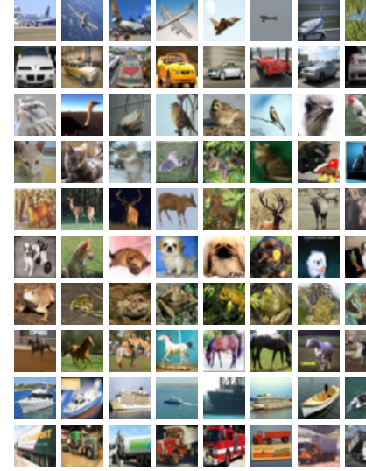
Neural Network Models for Object Recognition Using Classical ML (Track 1)
CIFAR-10 with PCA and SVM​

Slide 2

Introduction
Objective: Apply Classical ML for object recognition using CIFAR-10
Approach: Feature engineering using PCA + classification via SVM
Why it matters: Understand baseline ML vs. deep learning for vision tasks

Slide 3
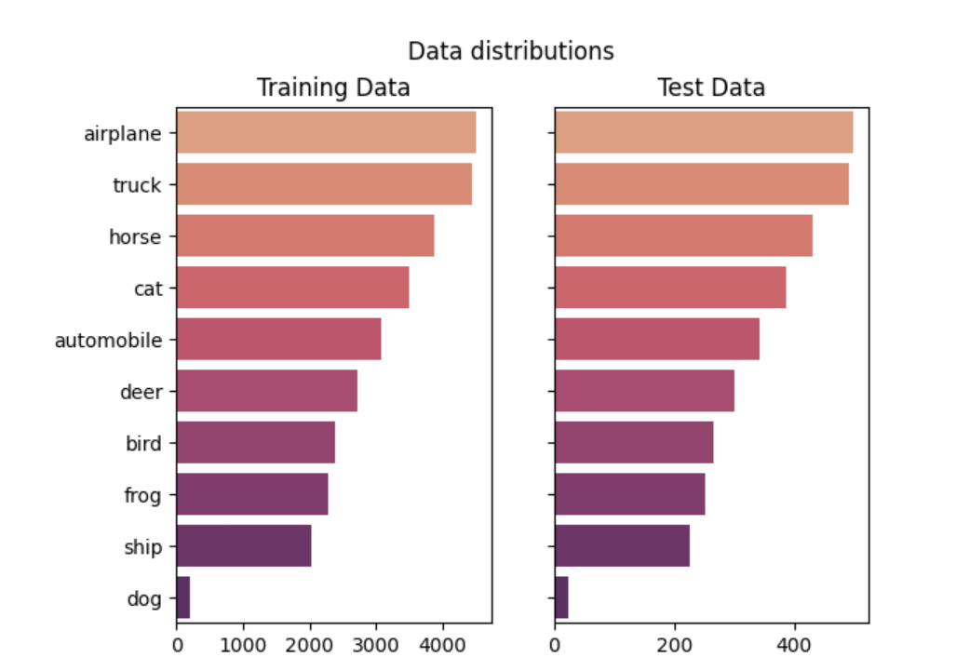
Dataset Overview– CIFAR-10
60,000 color images of size 32x32
10 object categories: Airplane, Automobile, Bird, Cat, etc.
Split:
50,000 for training
10,000 for testing

Slide 4
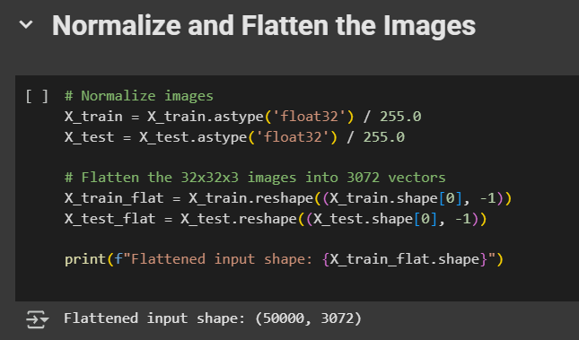
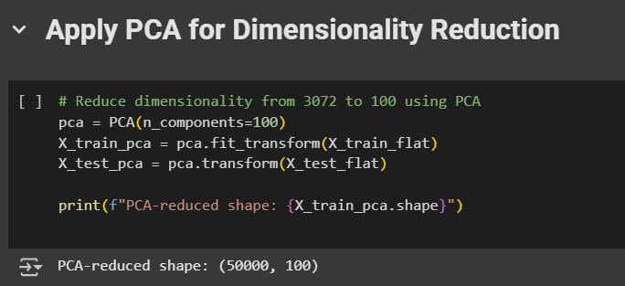
Data Preparation
Images normalized to range [0, 1]
Flattened to 3072-dimensional vectors
Applied PCA to reduce dimensionality to 100 features
Training data split: 80% train, 20% validation

Slide 5
Why Validation is Important
Prevents overfitting by testing on unseen data
Allows fine-tuning hyperparameters
Ensures model generalizes before final testing
Purpose | Why it matters
Prevent overfitting | Checks if the model is learning too much from training data only
Tune hyperparameters | Helps choose the best settings for the model
Test on unseen data | Makes sure the model can handle new, real-world data
Model selection | Helps compare and choose the best model

Slide 6
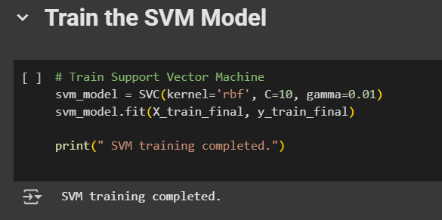
Classical ML Approach (Track 1)
No deep learning: SVM used instead
Feature reduction with PCA (100 components)
SVM classifier with RBF kernel
Parameters:
C=10, gamma=0.01, kernel='rbf'

Slide 7
Model Architecture & Hyperparameters
PCA: Retained ~95% of variance
SVM: RBF kernel for nonlinear classification
No epochs or batches (not applicable in classical ML)

Slide 8
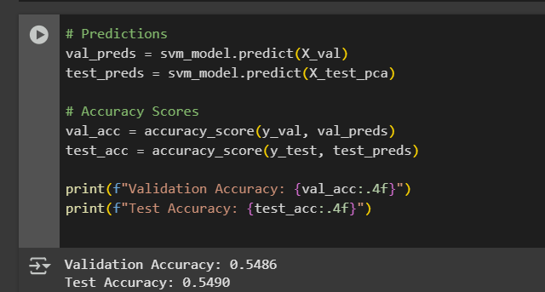
Performance Metrics
Validation Accuracy: ~54.85%
Test Accuracy: ~54.87%

Slide 9
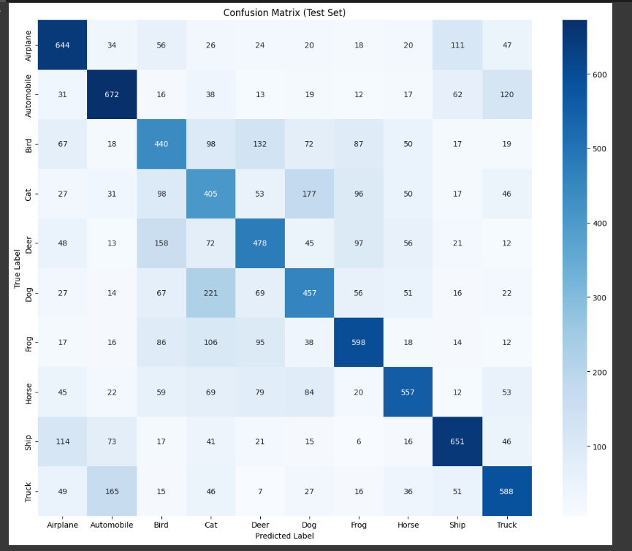
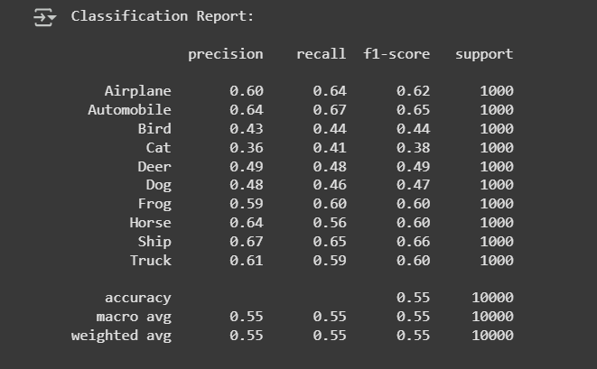
Confusion Matrix
Heatmap showing classification errors

Slide 10
Analysis of Results
Best performance: Ship, Truck, Automobile
Worst performance: Cat, Dog, Bird
Reason: low texture/similarity, limited feature extraction

Slide 11
Comparative Insights
Classical ML is:
Faster, interpretable, low-resource
Poor at feature abstraction vs. CNNs (Track 2)
Doesn’t adapt well to visual complexity like Deep Learning.

Slide 12
Lessons Learned
Importance of feature selection (PCA was vital)
Classical ML can set a baseline
SVM lacks robustness for high-dimensional image data
Trade-off: Speed vs. Accuracy

Slide 13
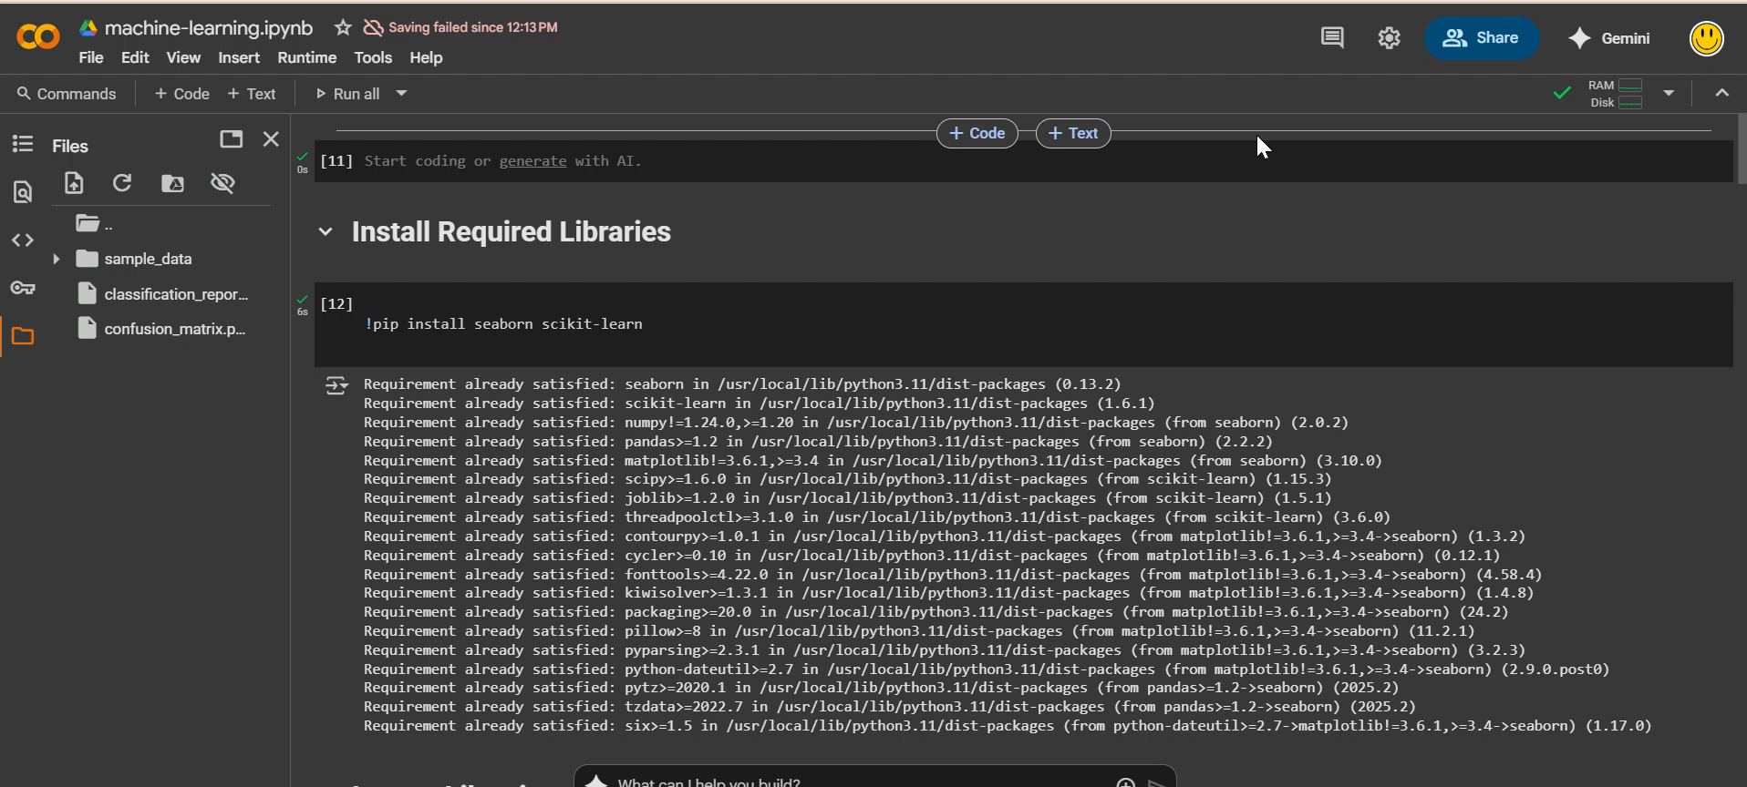
Demonstration

Slide 14
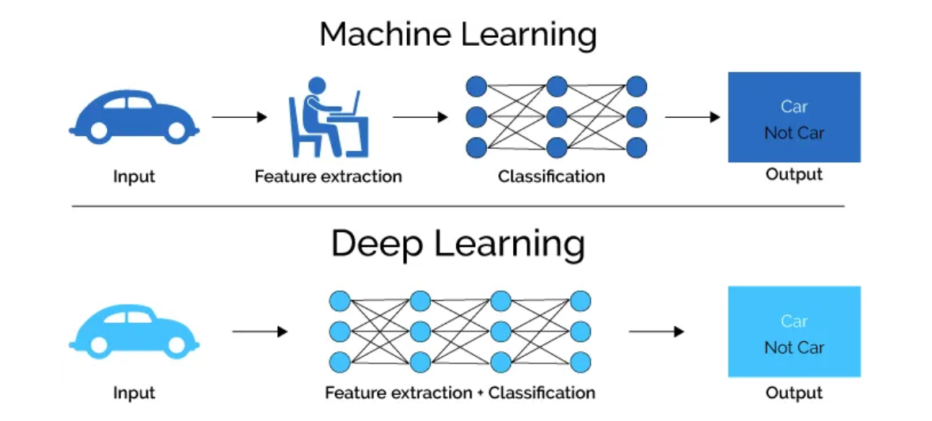
Conclusion
Classical ML is viable but limited for object recognition
Excellent for fast prototyping, low-resource scenarios
Deep learning is preferred for production

Slide 15
References
Hana, L. (2020). Classical ML vs. Deep Learning. [online] Medium. Available at: https://lamiae-hana.medium.com/classical-ml-vs-deep-learning-f8e28a52132d.
‌Krizhevsky, A. (2009). CIFAR-10 and CIFAR-100 datasets. [online] Toronto.edu. Available at: https://www.cs.toronto.edu/~kriz/cifar.html.
‌Scikit-learn.org. (2019). RBF SVM parameters — scikit-learn 0.21.3 documentation. [online] Available at: https://scikit-learn.org/stable/auto_examples/svm/plot_rbf_parameters.html.
‌Agarwal, D. (2021). Feature Extraction | Popular Feature Extraction Techniques. [online] Analytics Vidhya. Available at: https://www.analyticsvidhya.com/blog/2021/04/guide-for-feature-extraction-techniques/.
‌Vasileios Apostolidis-Afentoulis (2015). SVM Classification with Linear and RBF kernels. [online] doi:https://doi.org/10.13140/RG.2.1.3351.4083.

Slide 16
Thank you

